Slide 1
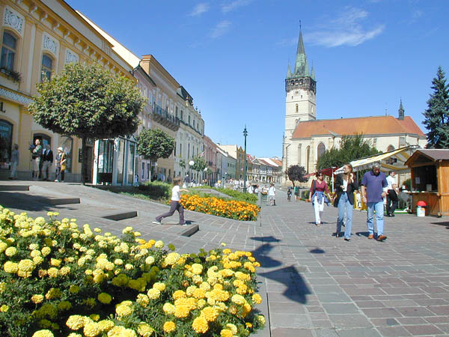
PREŠOV
Radoslav Vrškový

Slide 2
URBAN AREAS
Sídlisko III
Sídlisko II
Sekčov
Šváby

Slide 3
Sídlisko III
Housing development
The second largest
20 911 people
Urban part number 1
Construction started 1962

Slide 4
Sídlisko II
Housing development
9 742 people
Construction started 1963

Slide 5
Sekčov
Housing development
The largest
26 578 people
Construction started 1970

Slide 6
Šváby
Housing development
3 111 people
1970 attached as a part of Prešov

Slide 7
Thank you for you attention

